Slide 1
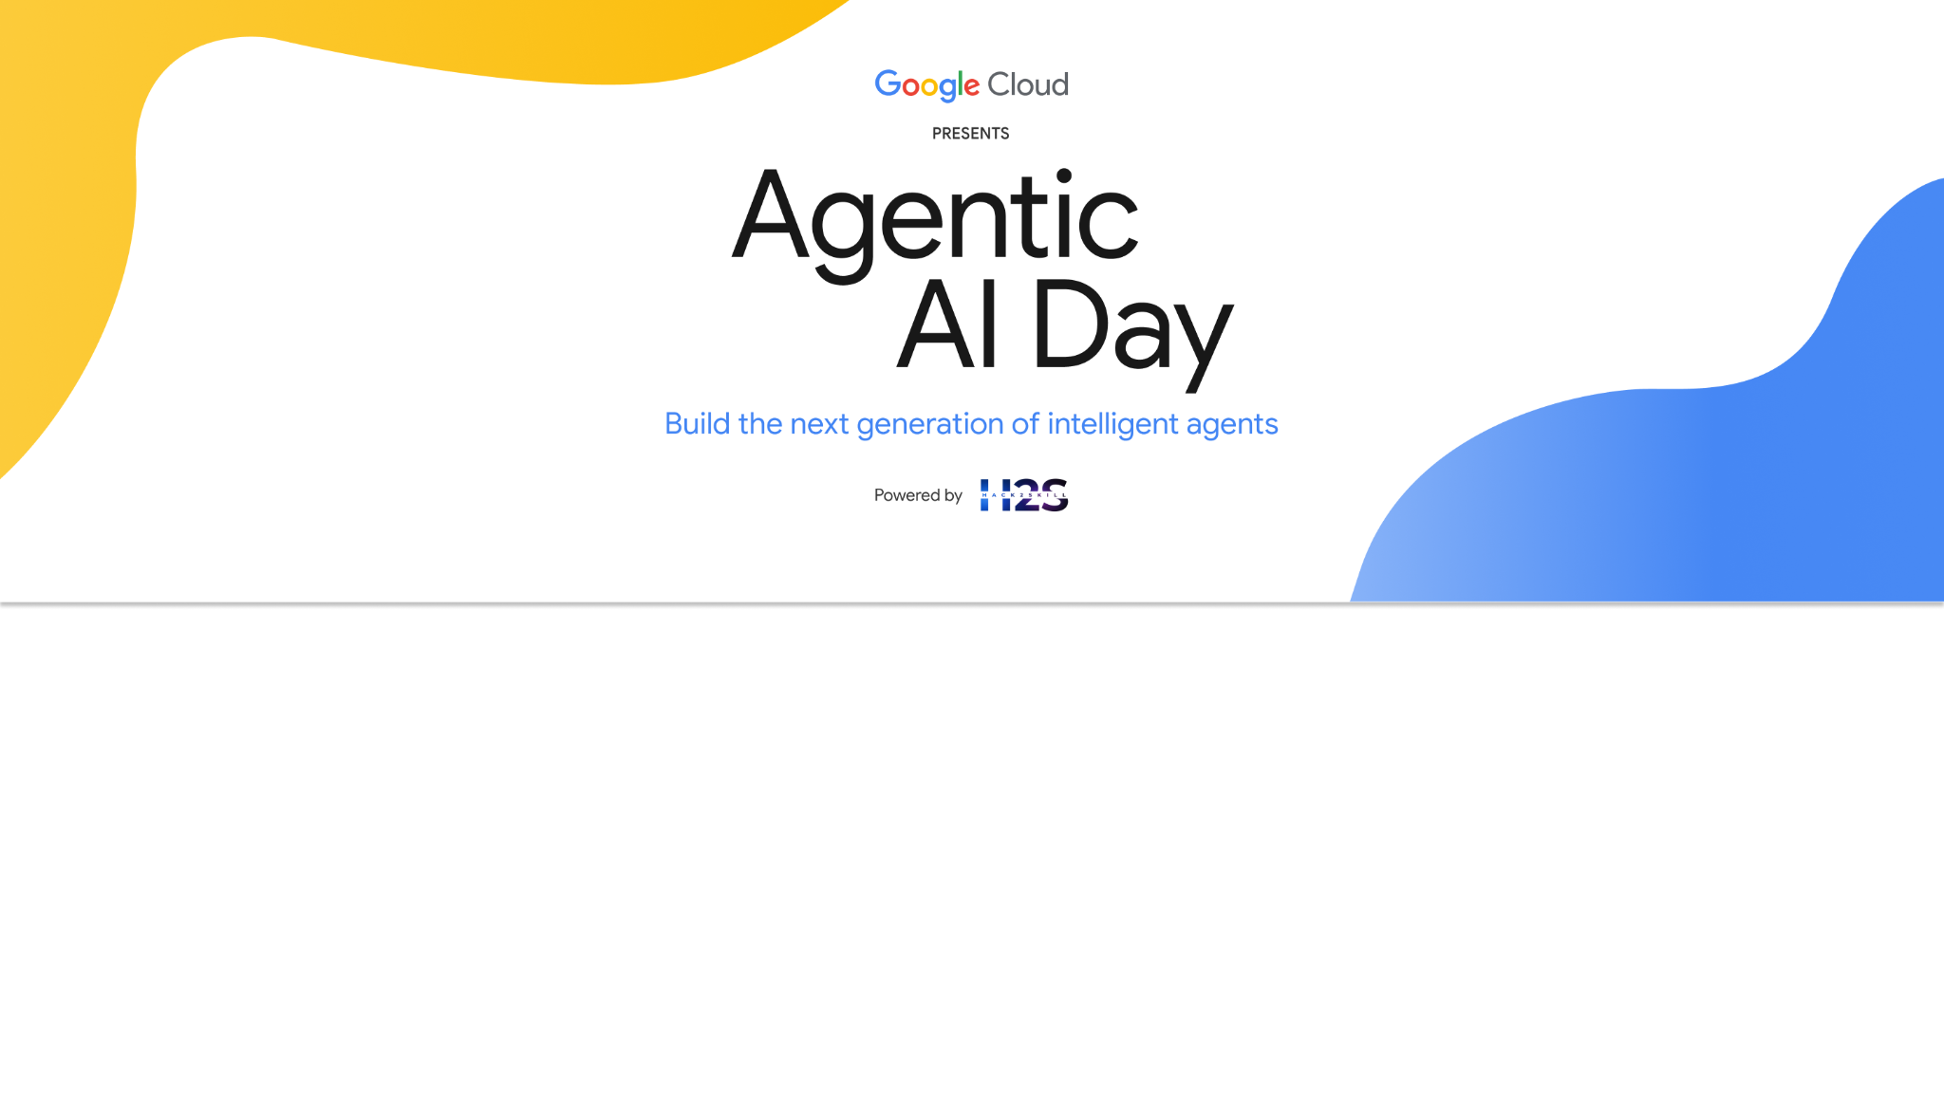
Team Details
Team name: AgentBlast
Team leader name: Ronakkumar Panchal & Priyanka Hundalekar
Problem statement: Providing Farmers with Expert Help on Demand

Slide 2
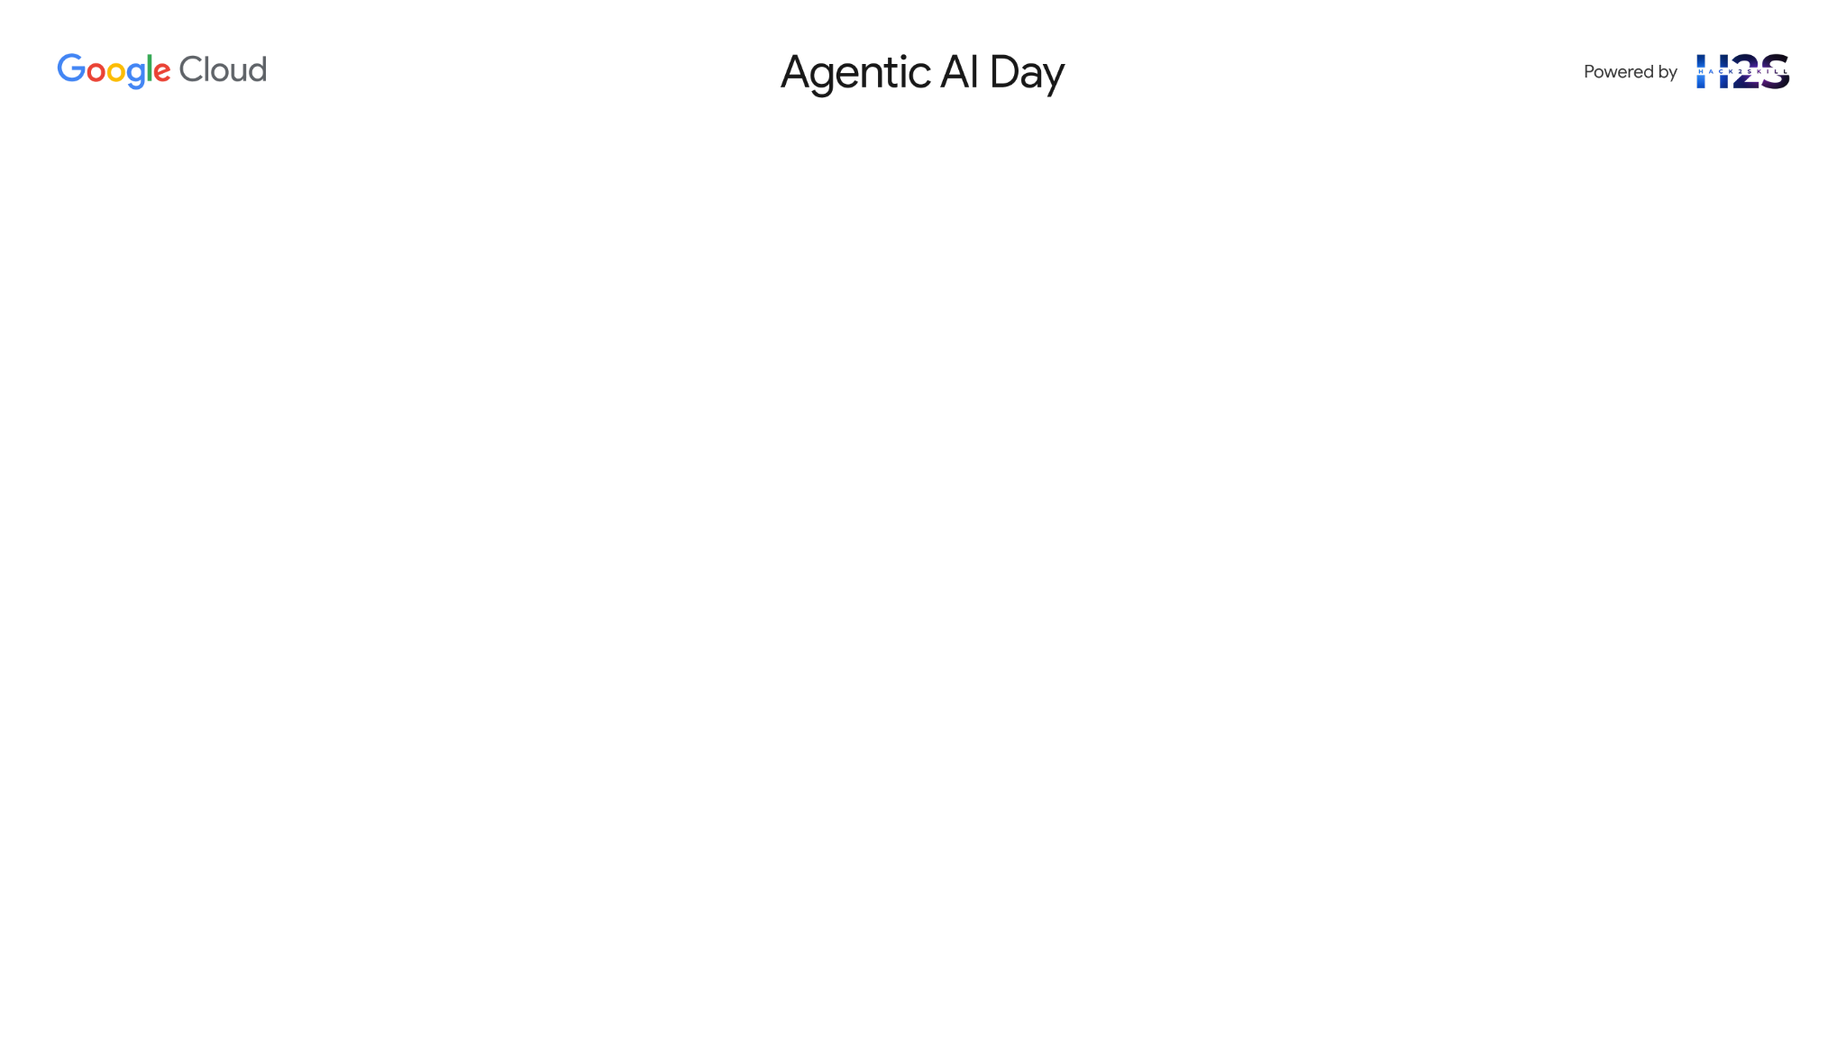
Brief about the idea
Title: Providing Farmers with Expert Help on Demand
Project Kisan: AI-Powered Personal Assistant for Smarter Farming
Concept: Build Project Kisan, an AI-powered multi-role agent that provides real-time expert help on demand for small-scale farmers.
The Agents involve are:
Orchestrator: Overall request handling, language detection, memory management, agent dispatch, STT/TTS.
Agronomist: Gives pest diagnosis and organic treatment advice.
Market Analyst: Recommends the best local markets for crop sales based on current prices.
Scheme Navigator: Identifies government schemes the farmer is eligible for.
Powered by:
A Neo4j Knowledge Graph: Map the entities and relationship between farmers, plots, crops, diseases, markets, and schemes
Google's Gemini 2.5 Pro LLM using LangChain ReAct agent architecture
Dynamic Cypher query generation based on user questions

Slide 3
Opportunities
1. How is it different from existing solutions?
Existing agri-apps are static (manual search, fixed rule-based systems)
Project Kisan is conversational, context-aware, and intelligent via Gemini LLM, multilingual voice over chat (support e.g. kannada)
Uses an AI + Neo4j graph database instead of flat tables → rich relationships, better reasoning, Real-time responses
2. How will it solve the problem?
Uses a Neo4j graph database instead of flat tables → rich relationships, better reasoning
Translates natural language questions into Cypher queries over a dynamic graph
Returns accurate, real-time, and personalized recommendations
Example: "What organic treatment works for whiteflies on cotton?" → Specific remedies with cost
3. Unique Selling Proposition (USP)?
Unified Expert Agent: One AI that handles agronomy, market, and schemes
AI + Graph Reasoning: Combines deep LLM reasoning with structured graph queries
Always-on Help: Farmers get expert help anytime, anywhere, in their local language (future roadmap)

Slide 4
List of features offered by the solution
Agents | Primary Task | AI Models/Services Used | Frameworks Used
Main Orchestrator | Overall request handling, language detection, memory management, agent dispatch, STT/TTS. | Chirp3 is used for TTS & STT ( Kanada e.g. kn-IN-Chirp3-HD-Achernar ) | LangChain ConversationBufferWindowMemory: Initializes and manages recent conversational history. Loads history for incoming requests, saves new interactions.
Intent Router Agent | Classifies user's primary intent (e.g., market price, disease, scheme, general). | Gemini Pro | Passes chat_history from LangChain memory to Gemini Pro for contextual intent classification.
Agronomist Agent | Diagnoses crop diseases from images, provides remedies and prevention tips. | Gemini Pro Vision | Passes chat_history from LangChain memory to Gemini Pro Vision for contextual understanding of text prompts alongside the image.
Market Analyst Agent | Extracts commodity/location, fetches market data, summarizes trends. | Gemini Pro, External Market Data API (conceptual) | Uses chat_history from LangChain memory for more accurate entity extraction and contextual summary generation.
Scheme Navigator Agent | Provides information and guidance on government agricultural schemes. | Gemini Pro, Vertex AI Search / RAG | Incorporates chat_history from LangChain memory for contextual understanding of scheme-related queries and generation of relevant guidance.
General Query Handling | Addresses any query that doesn't fit a specialized intent. | Gemini Pro | Addresses out of scope question
🌱 Agronomy Assistance
Diagnose crop problems (e.g., pests, diseases)
Recommend organic/chemical treatments
Suggest crop rotation and soil care
📈 Market Intelligence
Real-time market prices for crops
Recommend best marketplaces for selling
Analyze trends to maximize profit
🏛️ Government Scheme Navigator
Identify farmer eligibility for schemes
Guide application processes
List of benefits from ongoing/seasonal schemes
🧠 One Unified AI Agent
Automatically determines the farmer's intent
Converts queries to Cypher for knowledge graph lookup
Responds with simple, farmer-friendly explanations
📡 Neo4j Knowledge Graph-Driven
Context-aware reasoning using interconnected data
Links: Farmers ↔ Crops ↔ Markets ↔ Schemes ↔ Regions
🤖 Conversational, On-Demand Expert
Available 24/7 via chatbot interface
Adaptable to local languages and voice inputs

Slide 5
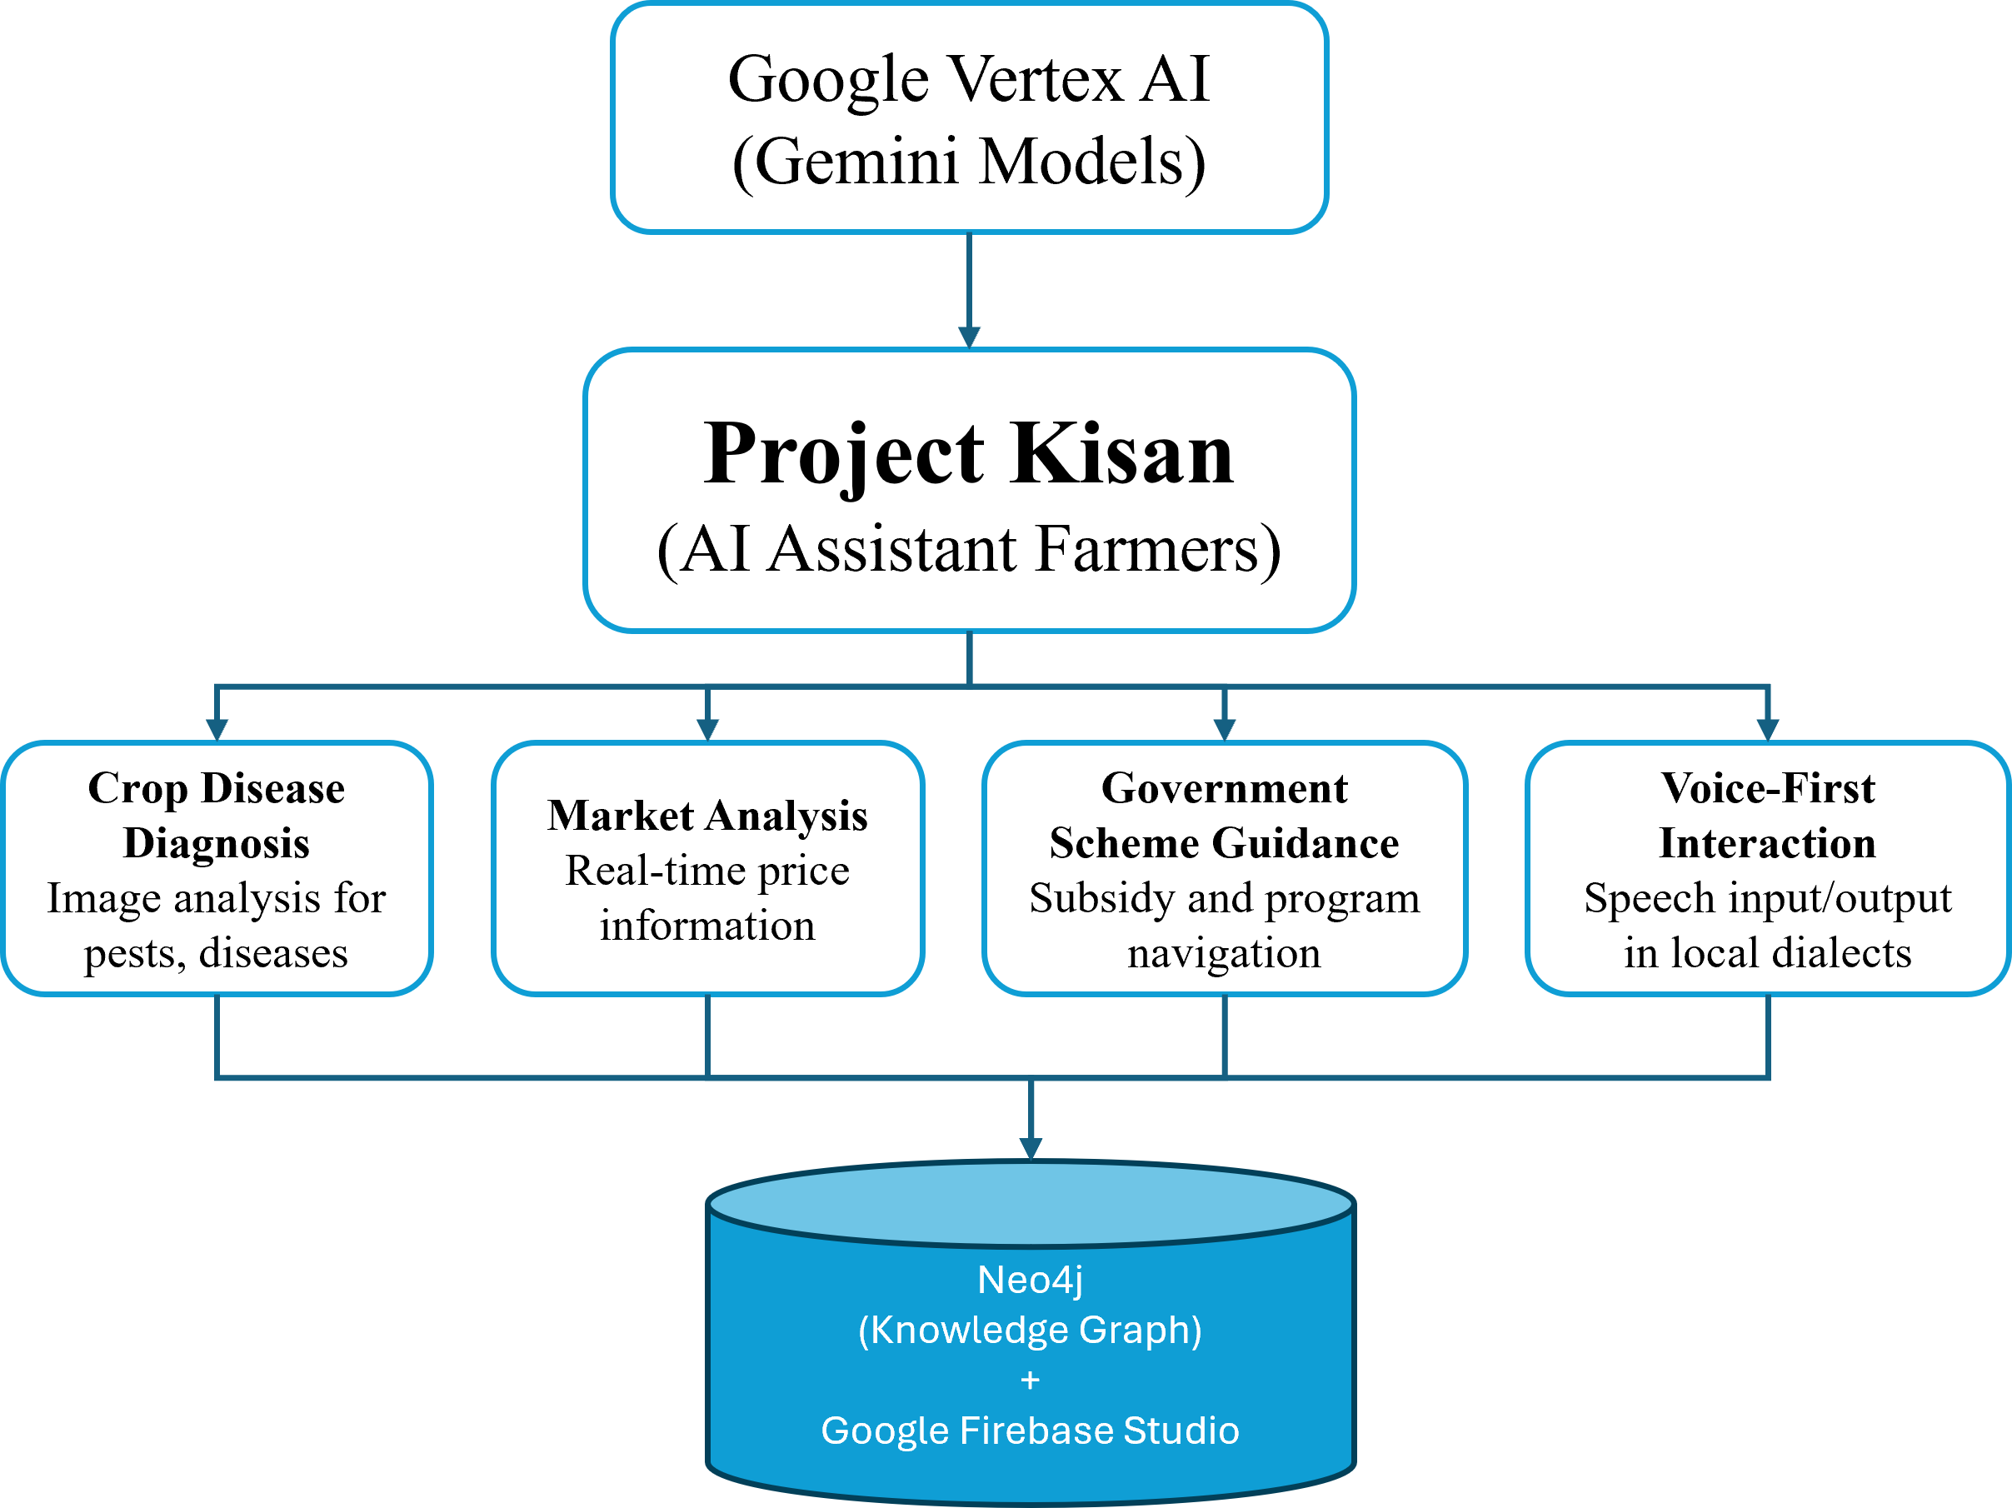
Process flow diagram
Project Kisan based intelligent flow:
Project Kisan is an AI-powered assistant for farmers built on Google Vertex AI's Gemini Models.
It features four core services: Crop Disease Diagnosis, Market Analysis, Government Scheme Guidance, and Voice-First Interaction.
Crop Disease Diagnosis uses image analysis to detect pests and diseases in crops.
Market Analysis provides farmers with real-time price data via public market APIs.
Government Scheme Guidance helps farmers navigate subsidies and government programs.
Voice-First Interaction enables communication in local dialects using speech input/output.
The system integrates with Google Firebase and Neo4j Knowledge Graph to support data flow and intelligent responses.

Slide 6
Technologies to be used in the solution
Component | Technology
💬 LLM Agent Brain | Google Vertex AI (Gemini 2.5 Pro)
🧠 Agent Framework | LangChain (ReAct Agent, Tool abstraction)
🔗 Knowledge Graph DB & DB | Neo4j AuraDB + Firestore Studio
🛠️ Query Tooling | Custom Cypher execution via LangChain Tool
📦 Agent Orchestration | AgentExecutor from LangChain / Google - ADK
🧾 Prompt Design | Custom ReAct prompt template tuned for agriculture
🌐 Deployment | Google Cloud (App Engine or Vertex Pipelines)
🧪 Data Model | Nodes: Farmer, Crop, Market, Scheme, etc. Edges: OWNS, TRADES_CROP_AT_PRICE, IS_ELIGIBLE_FOR

Slide 7
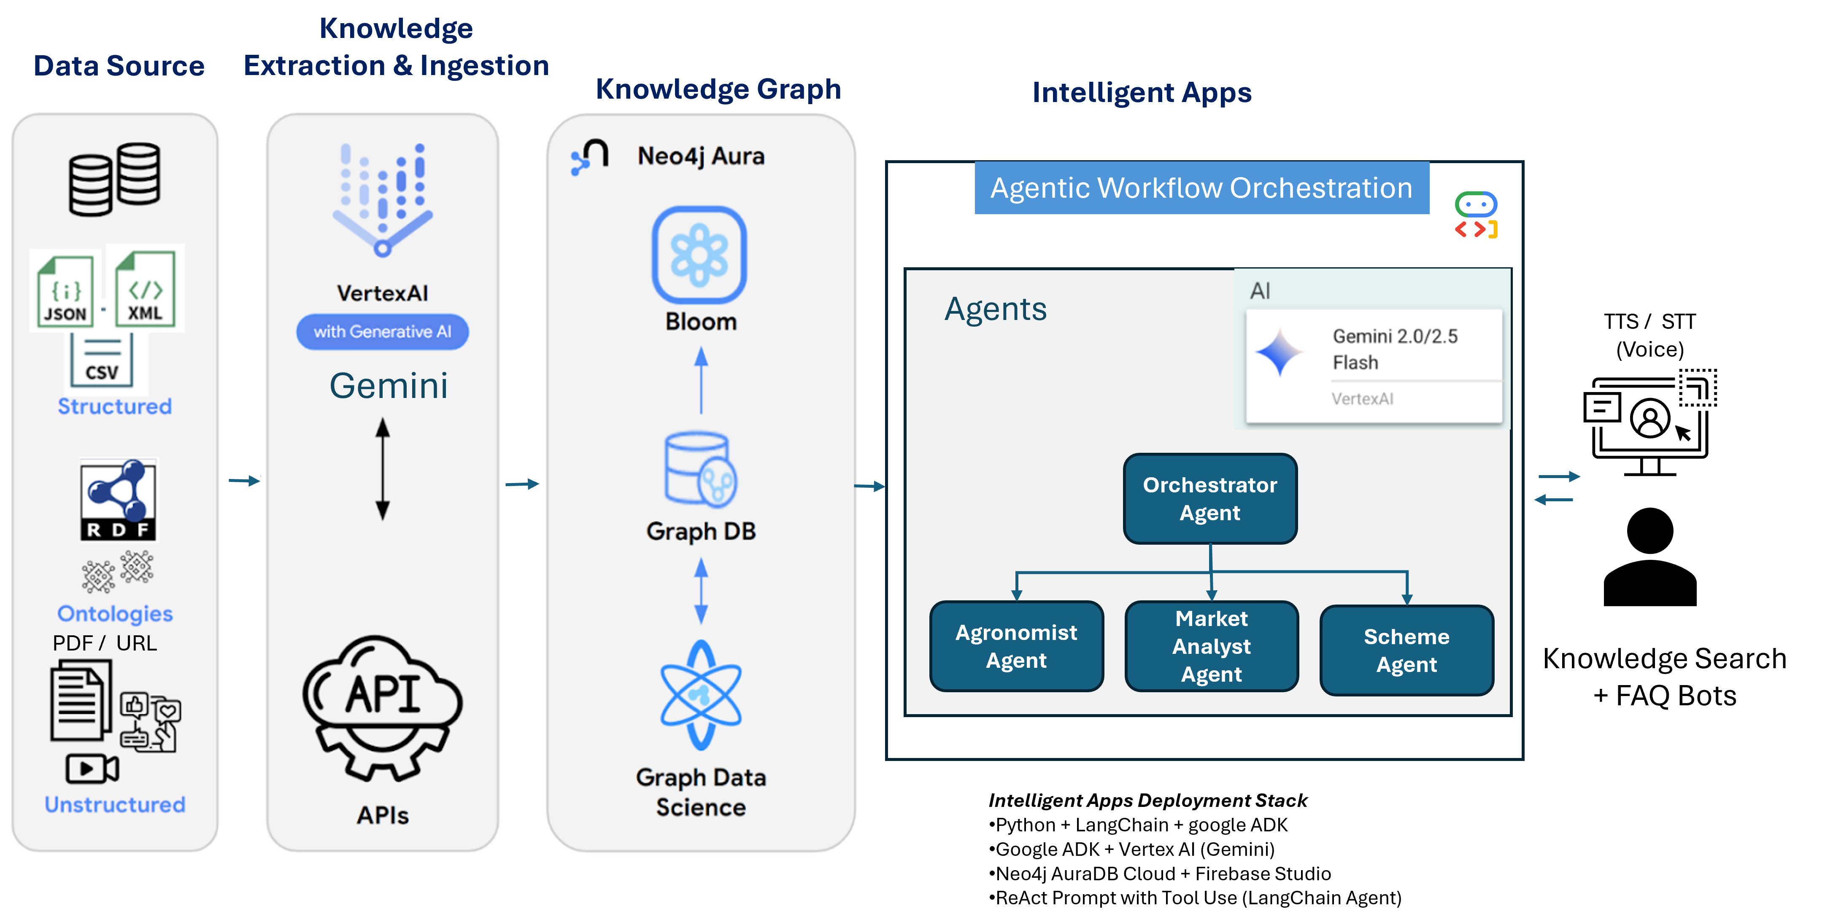
Architecture diagram of the proposed solution

Slide 8
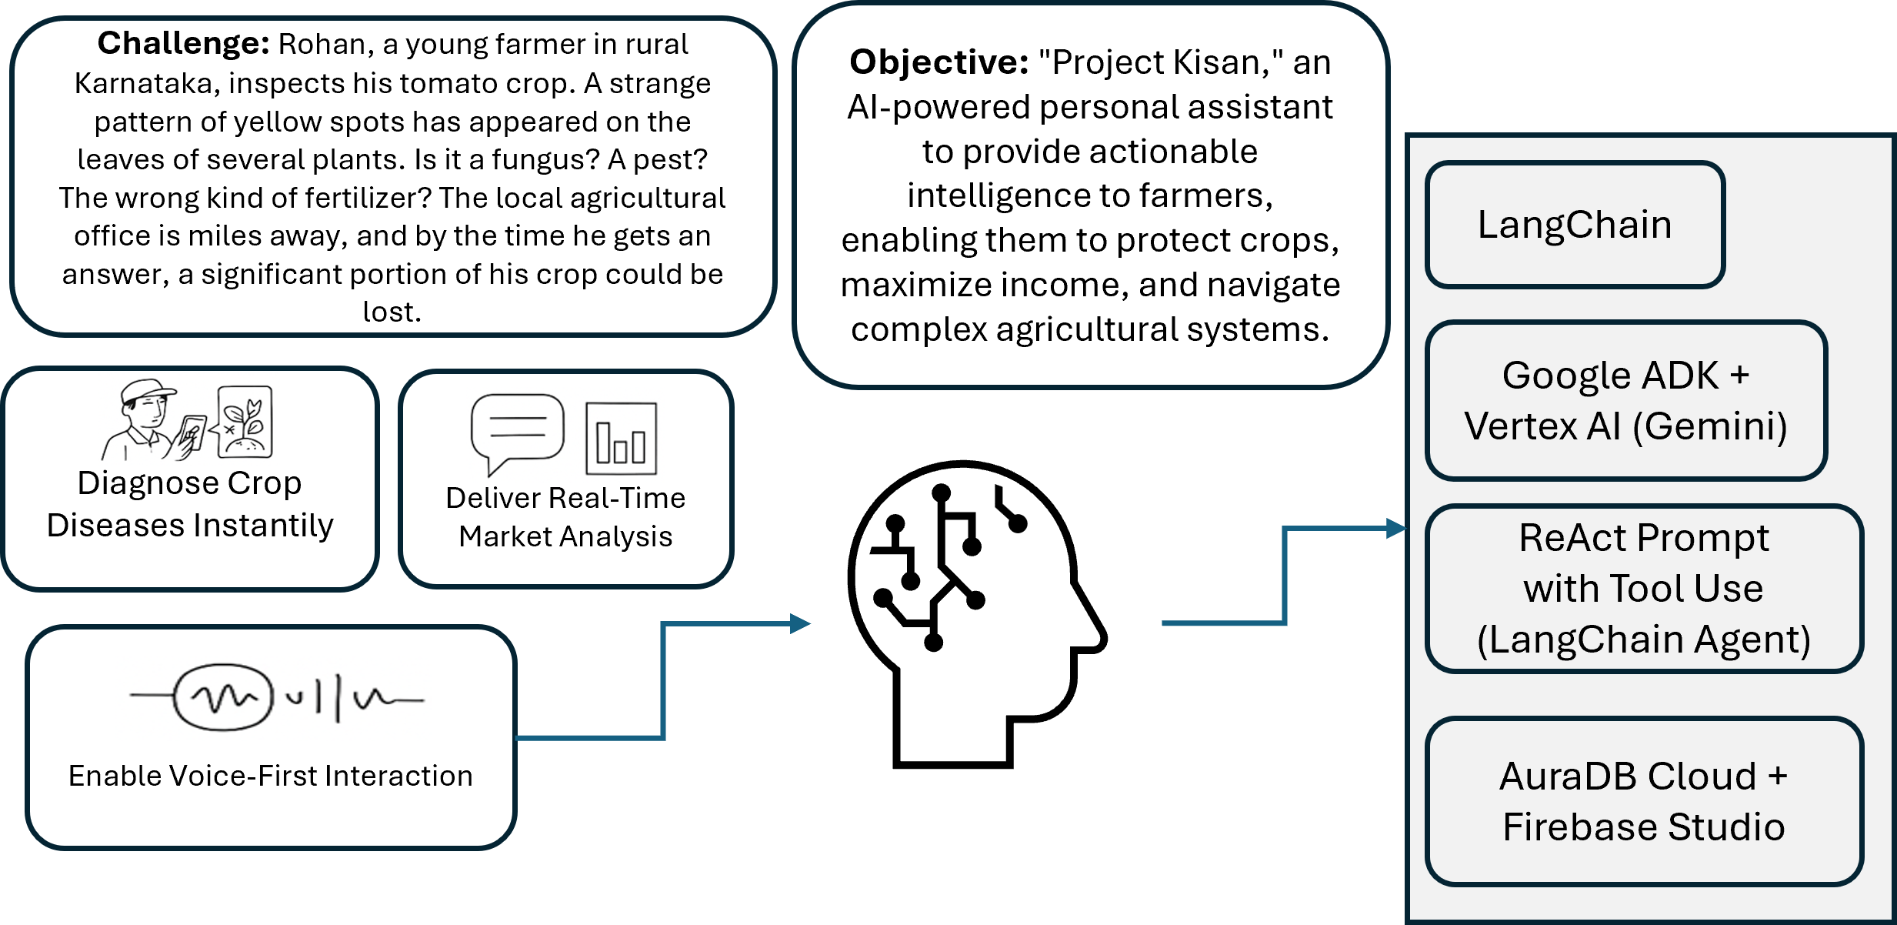
Wireframes/Mock diagrams of the proposed solution (optional)

Slide 9
How to benefit farmers using Project Kisan
Capability | Transformation Delivered
🦠 Disease Diagnosis | Instantly identify crop issues from a photo using Gemini multimodal model; no need to visit an agriculture office.
📈 Market Insights | Real-time analysis of mandi prices through Gemini + APIs, helping choose when and where to sell.
🏛️ Scheme Navigation | Simplified guidance on government subsidies, eligibility, and application—powered by KG + Gemini LLM.
🗣️ Voice Interface | Full Kannada voice interaction (via Vertex AI Speech APIs) to overcome literacy/language barriers.
📊 Personalized AI Assistant | Unified interface powered by Google ADK, acting as agronomist, market advisor, and subsidy expert—on demand.

Slide 10
